Slide 1


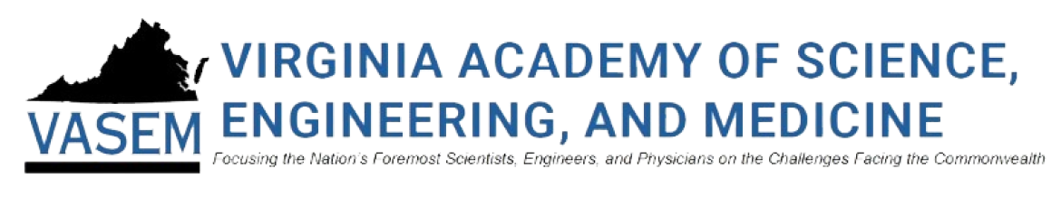



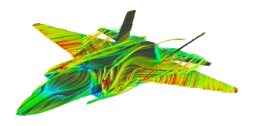
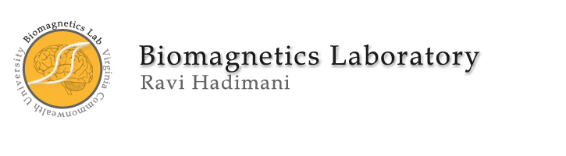




Pavan Chaitanya
Master of Science (M.S.)
in
Mechanical and Nuclear Engineering

Slide 2
About Me
Detail-oriented Mechanical Engineer with experience in energy analysis, mechanical design, analysis, and system integration. Proficient in 3D CAD tools including SolidWorks, Siemens NX and Creo.
Experienced in product design, development and troubleshooting, with strong capabilities in FEA, thermal analysis, and tolerance analysis. I am skilled in thermal systems, fluid flow, and manufacturing processes with a proven ability to develop clear engineering documentation and collaborate effectively across cross-functional teams.
I enjoy working at the intersection of creativity and technical precision. I thrive in collaborative environments, constantly driven by curiosity and the desire to build solutions that are both impactful and efficient. de.

Slide 3
What Drives Me
I am driven by curiosity and the challenge of turning complex engineering problems into practical solutions that make a difference. The blend of analytical thinking and hands-on creation fuels my passion for innovation. Whether it’s energy analysis, advancing magnetic materials, performing detailed design and analysis, I find purpose in learning continuously and applying that knowledge to improve technology and impact lives. Above all, I’m motivated by the opportunity to contribute meaningfully through research, design, or collaboration, and to keep growing as an engineer and problem solver.

Slide 4
What Makes Me Unique
With expertise in mechanical and nuclear engineering, I specialize in magnetic materials, thermal systems, and advanced manufacturing, combining simulation, design, and interdisciplinary research to deliver innovative, practical solutions. My experience spans energy analysis, motorsports, academic research, industrial prototyping, supply chain, and policy, shaping me into a critical thinker and hands-on problem solver capable of managing projects.

Slide 5
Looking Ahead
As I continue to grow as an engineer and researcher, I’m driven by a desire to work at the intersection of innovation and impact. I aim to contribute to cutting-edge projects that advance technologies in magnetic materials, thermal systems, and advanced manufacturing. My goal is to collaborate with multidisciplinary teams, take on challenging problems, and ultimately help shape solutions that improve both industry practices and people's lives. Whether in research, development, or design, I’m excited to keep learning, building, and pushing the boundaries of what’s possible.

Slide 6
Research Paper Publications
Novel conformable shielding permalloy composite for controlling field profiles of transcranial magnetic field coils
Experimental investigations on the position of plates in friction stir welding of dissimilar alloys
Influence of X-ray Irradiation on the Magnetic and Structural Properties of Gadolinium Silicide Nanoparticles

Slide 7
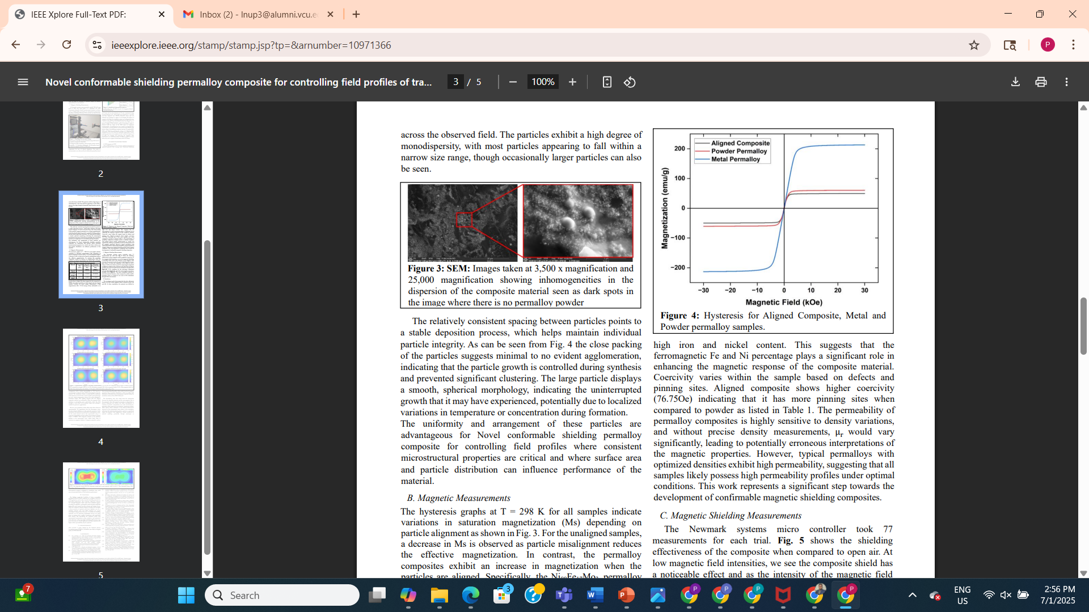
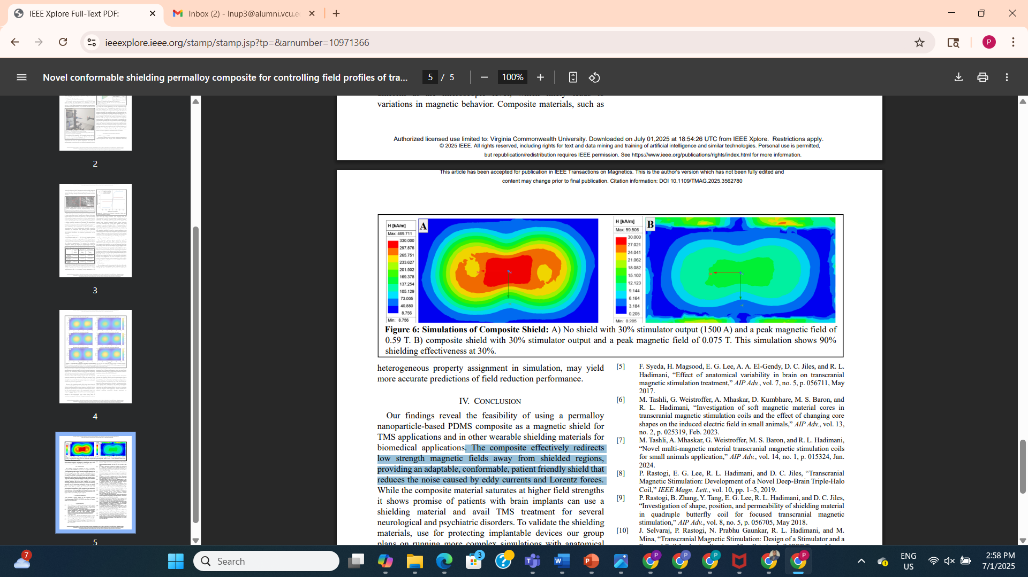
Novel conformable shielding permalloy composite for controlling field profiles of transcranial magnetic field coils
SEM Image at 3500x
A heavily loaded polydimethylsiloxane (PDMS) permalloy composite can effectively shield low strength magnetic fields from TMS coils. The composite saturates quickly with higher fields but with some modifications and further study it shows promise as a conformable shielding material for TMS and other wearable shielding of low frequency and DC magnetic field applications.
The composite effectively redirects low strength magnetic fields away from shielded regions, providing an adaptable, conformable, patient friendly shield that reduces the noise caused by eddy currents and Lorentz forces.
Hysteresis for different permalloy samples
Simulation Results of Composite Shield

Slide 8
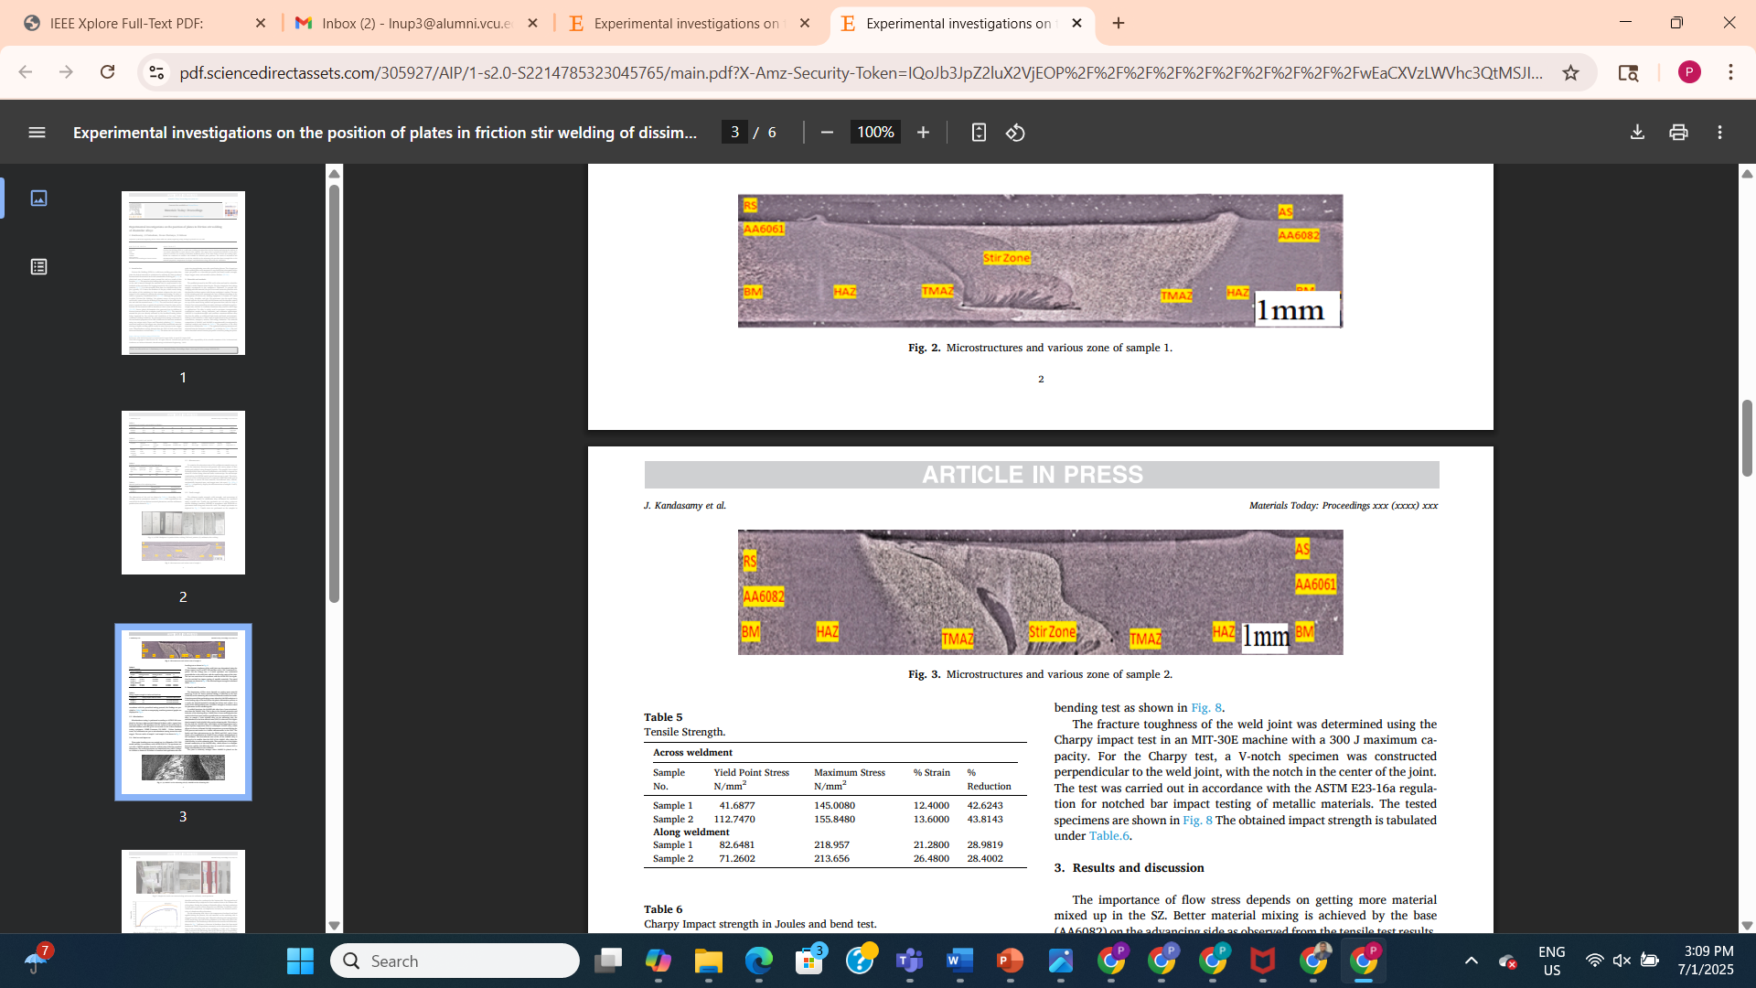
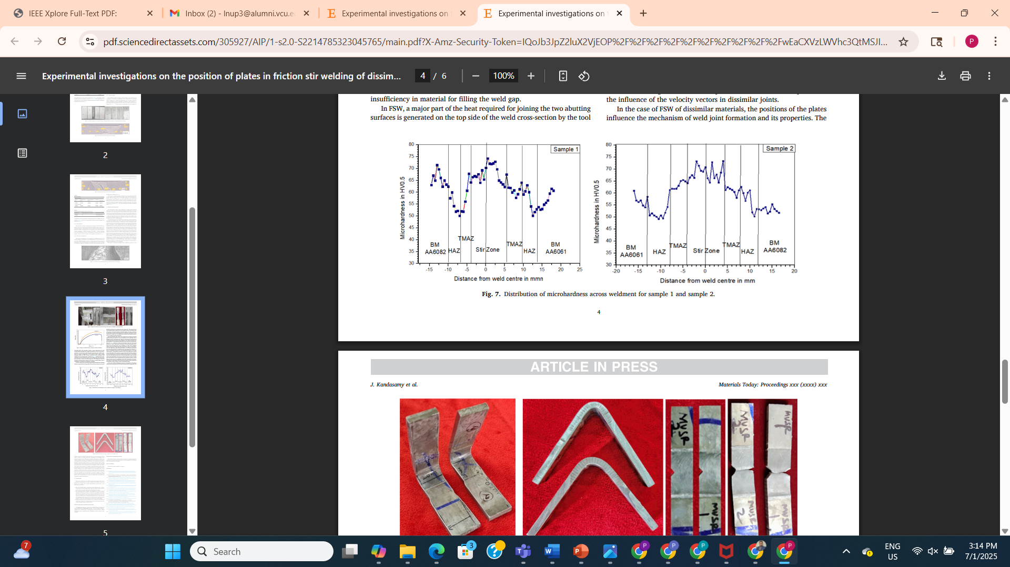
Experimental investigations on the position of plates in friction stir welding of dissimilar alloys
Microstructures and various zone of sample 1
When the AA6082 plate is positioned on the advancing side, a defectfree junction can be formed, while when the AA6061 plate is placed on the advancing side, substantial volume flaws are seen.
The maximum tensile strength value obtained is 218.957 N/mm2 along the weldment in sample 1 on AA6082, the nugget’s advancing side has a microhardness value is 75 which is higher than its AA6061 side.
The movement of the mixed materials at the stir zone, the creation of IMCs, and the distinction between the stir zone and the thermomechanically affected zone are all shown by macrostructural analysis.
Microstructures and various zone of sample 2
Distribution of microhardness across weldment for sample 1 and sample 2.

Slide 9
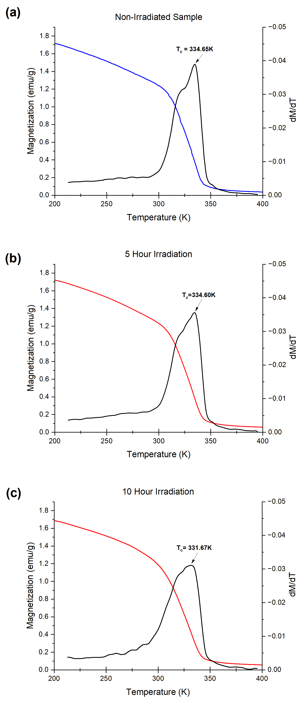
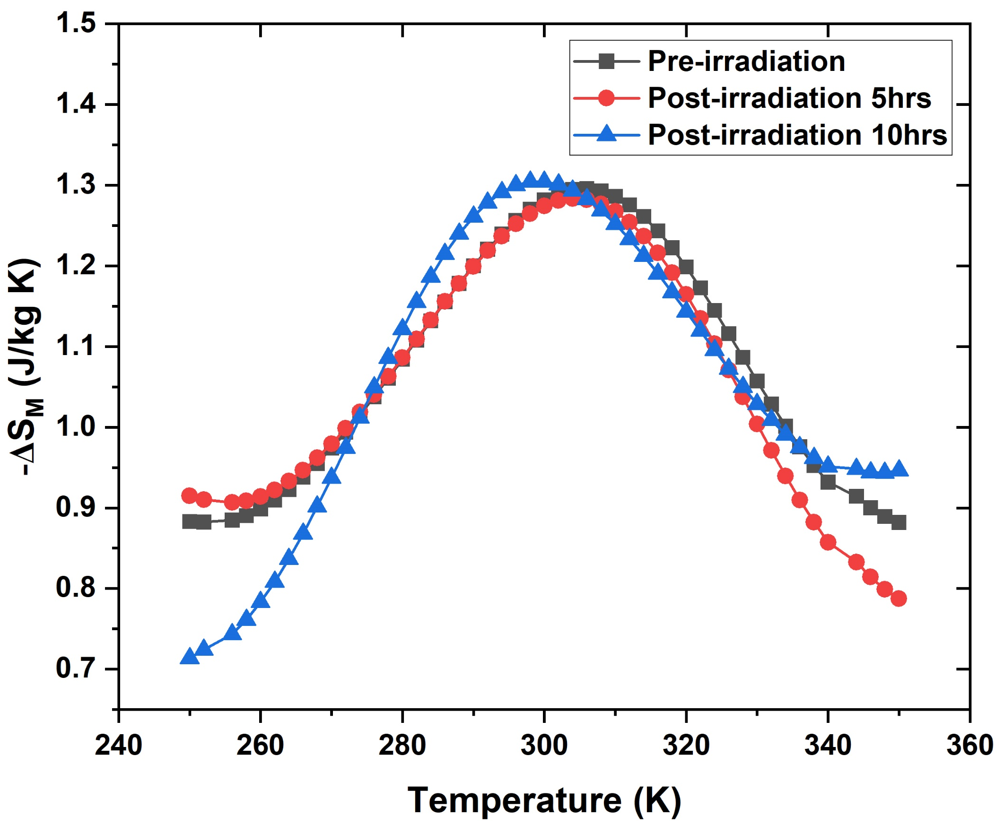
Influence of X-ray Irradiation on the Magnetic and Structural Properties of Gadolinium Silicide Nanoparticles
This study concludes that gadolinium silicide (Gd5Si4) nanoparticles exhibit stability in their magnetic and structural properties when exposed to high-dose (up to 72 kGy) and high-dose-rate (120 Gy/min) X-ray irradiation despite localized lattice distortions.
These findings demonstrate the stability of Gd5Si4 nanoparticles under high-dose irradiation, supporting their potential application in combined therapeutic modalities such as magnetic hyperthermia and irradiation therapy. Furthermore, their resilience in high-energy, high-intensity radiation fields highlights their potential use in nuclear environments.
Temperature-dependent magnetic entropy change (ΔS_{M}) of pre- and post-irradiated samples for 5h and 10h.
Magnetization (M) as a function of temperature (T) at 100 Oe applied magnetic field when measured as (a) non-irradiated, and after X-ray irradiation for (b) 5h and (c) 10h of. The transition temperature was determined from dM/dT.

Slide 10
Research Papers under Review
Magnetocaloric Properties of Gd1-xErxNiAl Alloys near Hydrogen Liquefaction Temperatures
Investigation of Magnetic Field-Induced Phase Transition Ni50Mn28Ga22, Ferromagnetic Shape Memory Alloy

Slide 11
Influence of X-ray Irradiation on the Magnetic and Structural Properties of Gadolinium Silicide Nanoparticles
Magnetic hyperthermia treatment (MHT) utilizes heat generated from magnetic nanoparticles (MNPs) under an alternating magnetic field (AMF) for therapeutic applications.
Gadolinium silicide (Gd5Si4) has emerged as a promising MHT candidate due to its self-regulating heating properties and potential biocompatibility. However, the impact of high-dose X-ray irradiation on its magnetic behavior remains uncertain.
This study examines Gd5Si4 nanoparticles exposed to 36 and 72 kGy X-ray irradiation at a high-dose rate (120 Gy/min).
Our findings confirm the stability of Gd5Si4 under high-dose X-ray irradiation, supporting its potential for radiotherapy (RT) and magnetocaloric cooling in deep-space applications.

Slide 12

Achievements
Received Scholarship from Student Success Fund for all semesters during my master’s.
Secured 1st at state level in SAE Tier 2 event in Mechatronics (2020).
Commonwealth of Virginia Engineering and Science (COVES) Fellowship Awardee.
Secured 1st in (2020), 3rd in (2018) at state level in Mobile Robotics of SAE Tier 2 events.

Slide 13
Poster Presented at VASEM Sustainable Energy Summit 2024 at Dominion Energy Headquarters

Slide 14



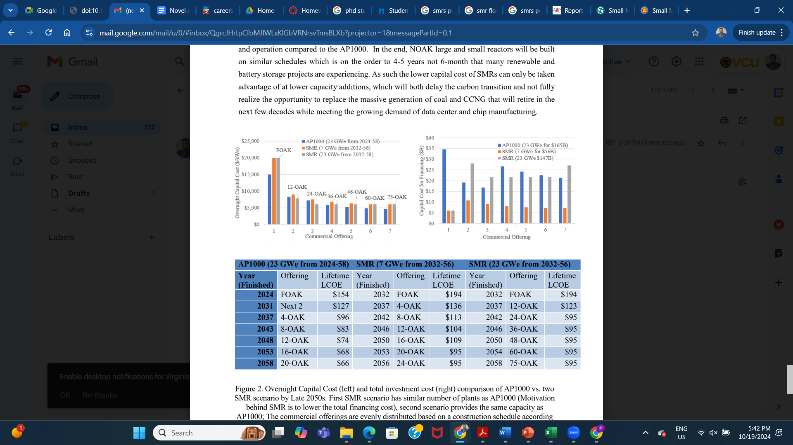
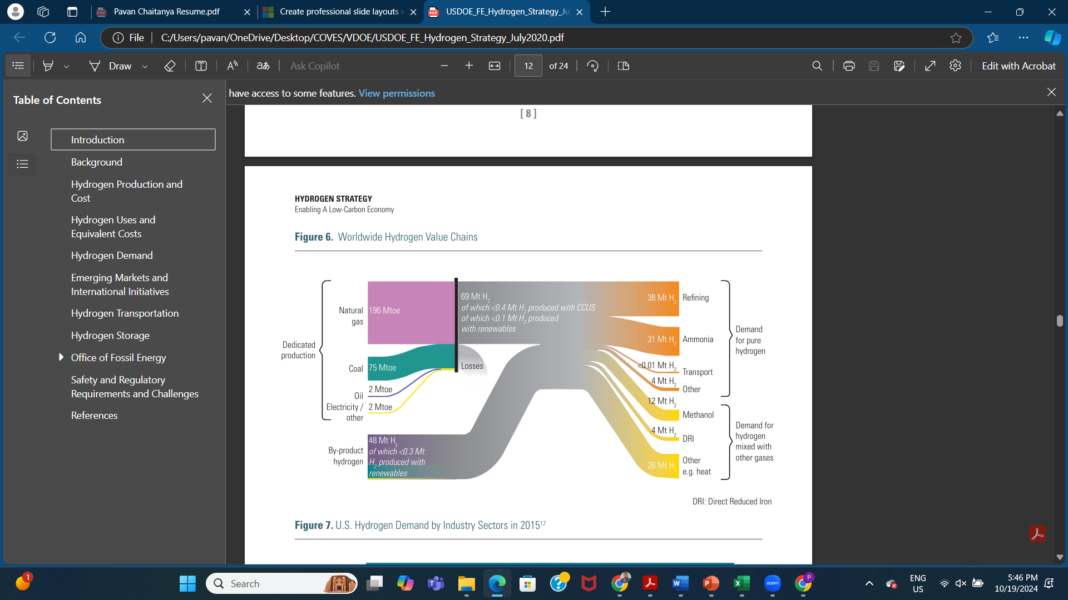
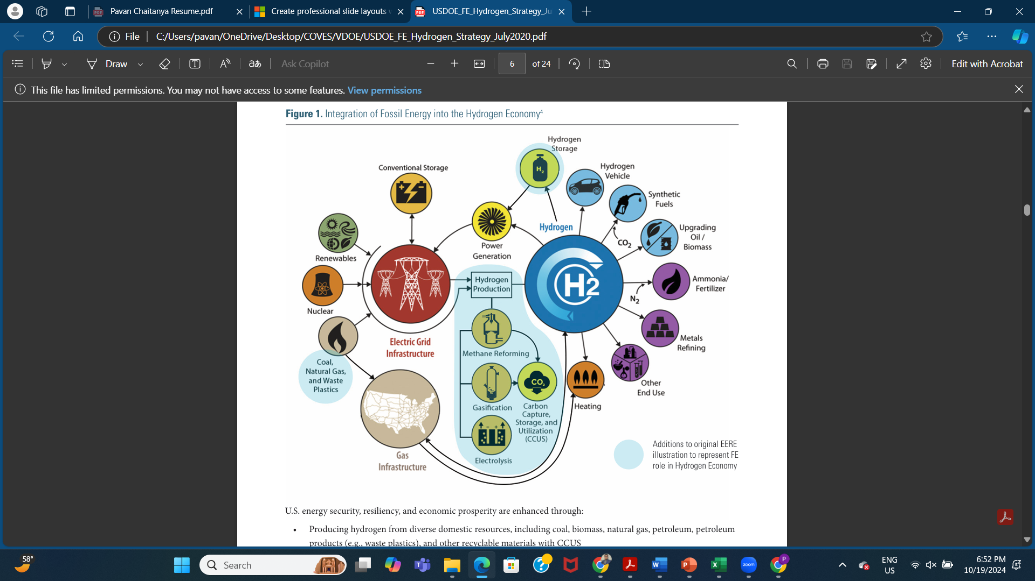
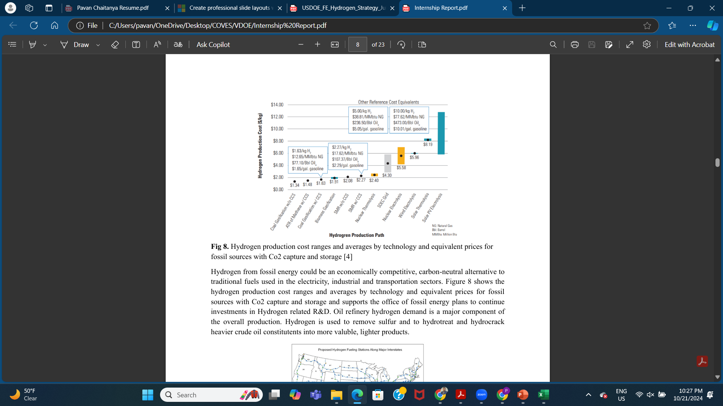
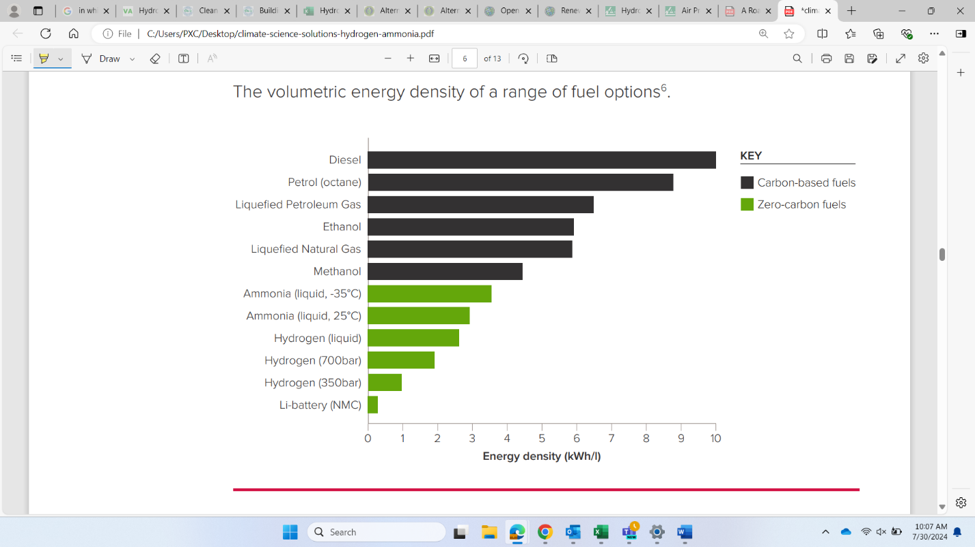
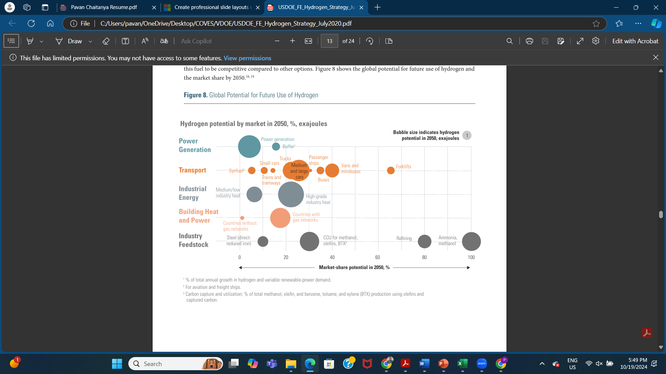
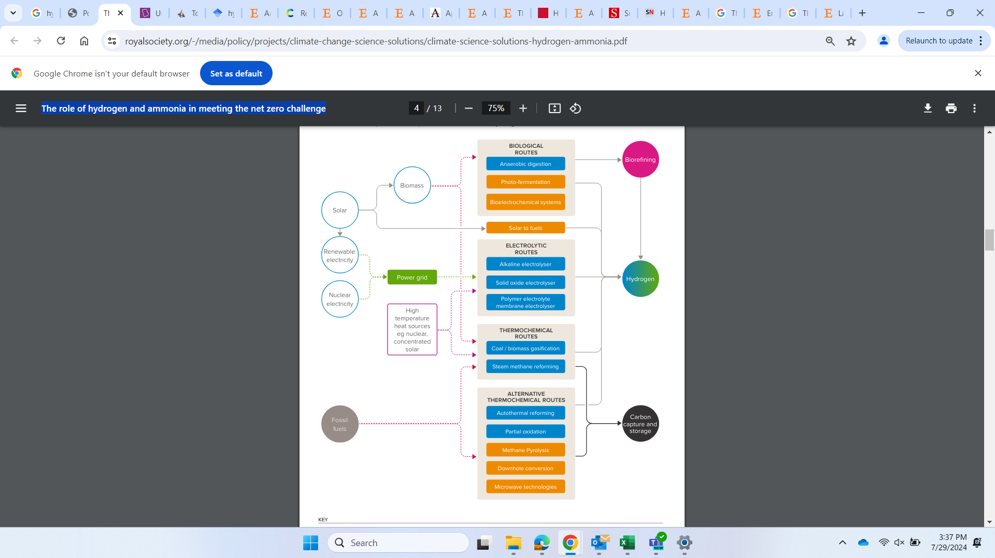
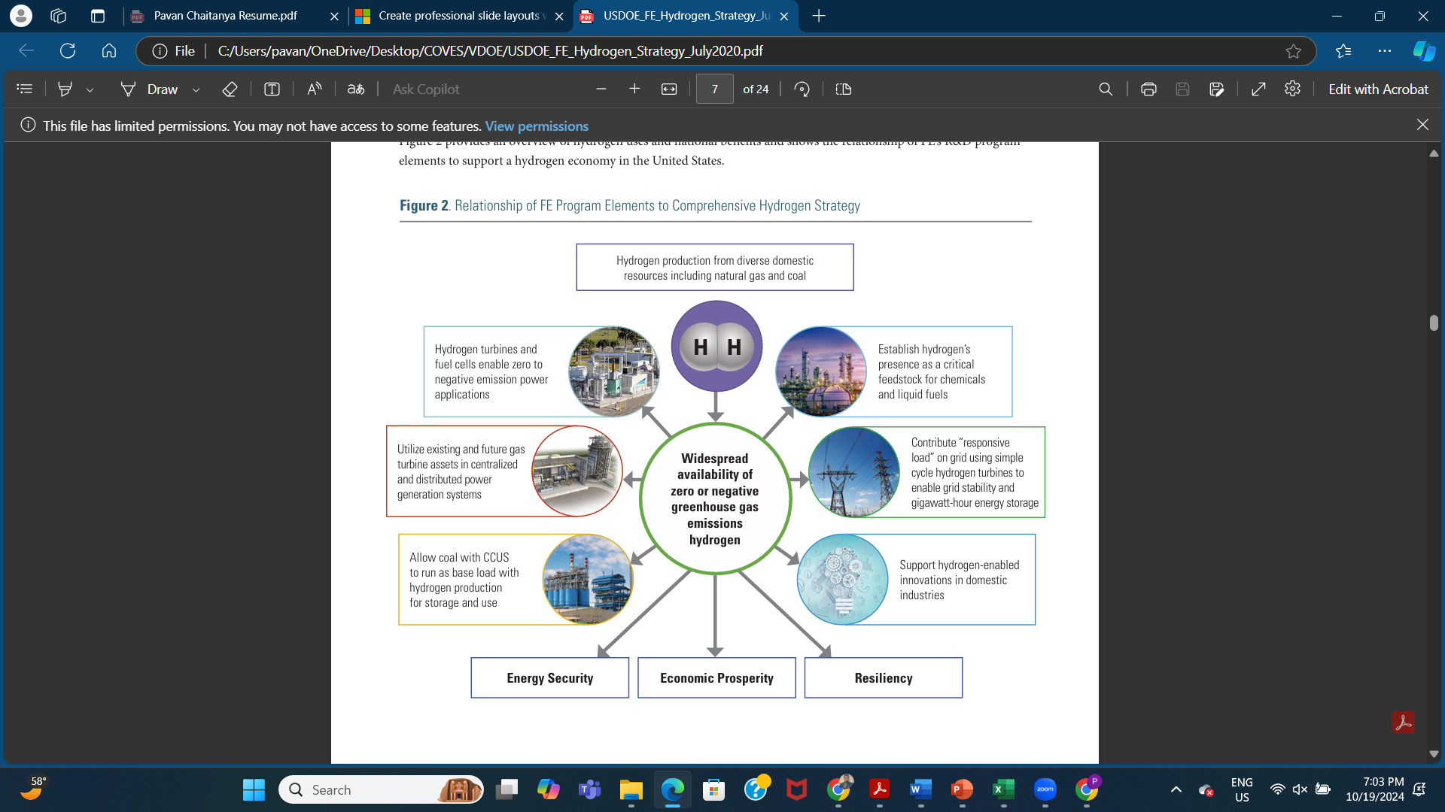
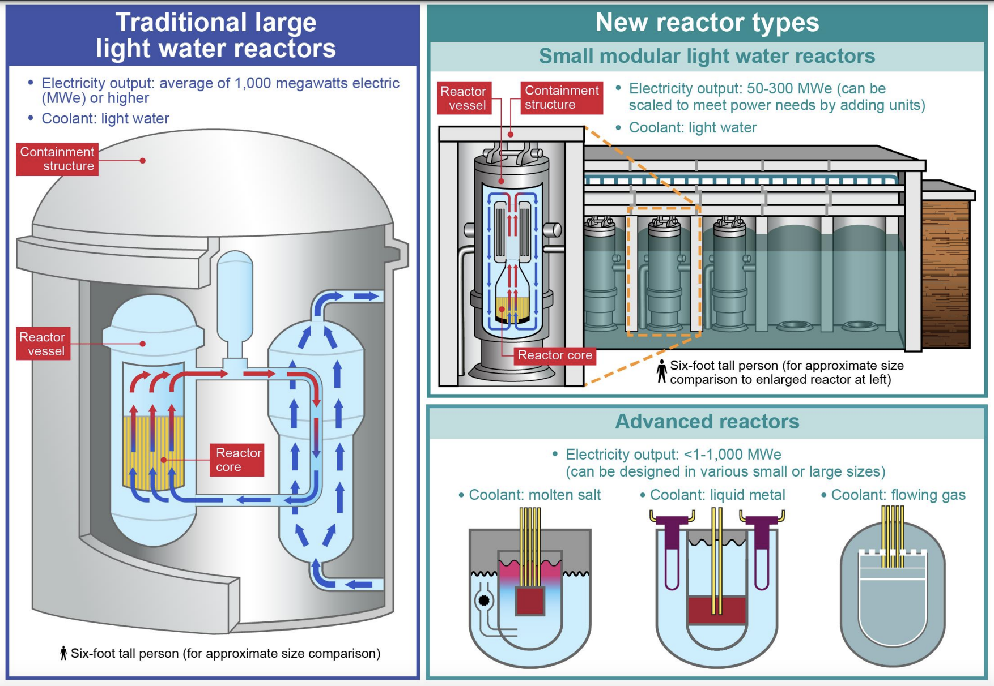
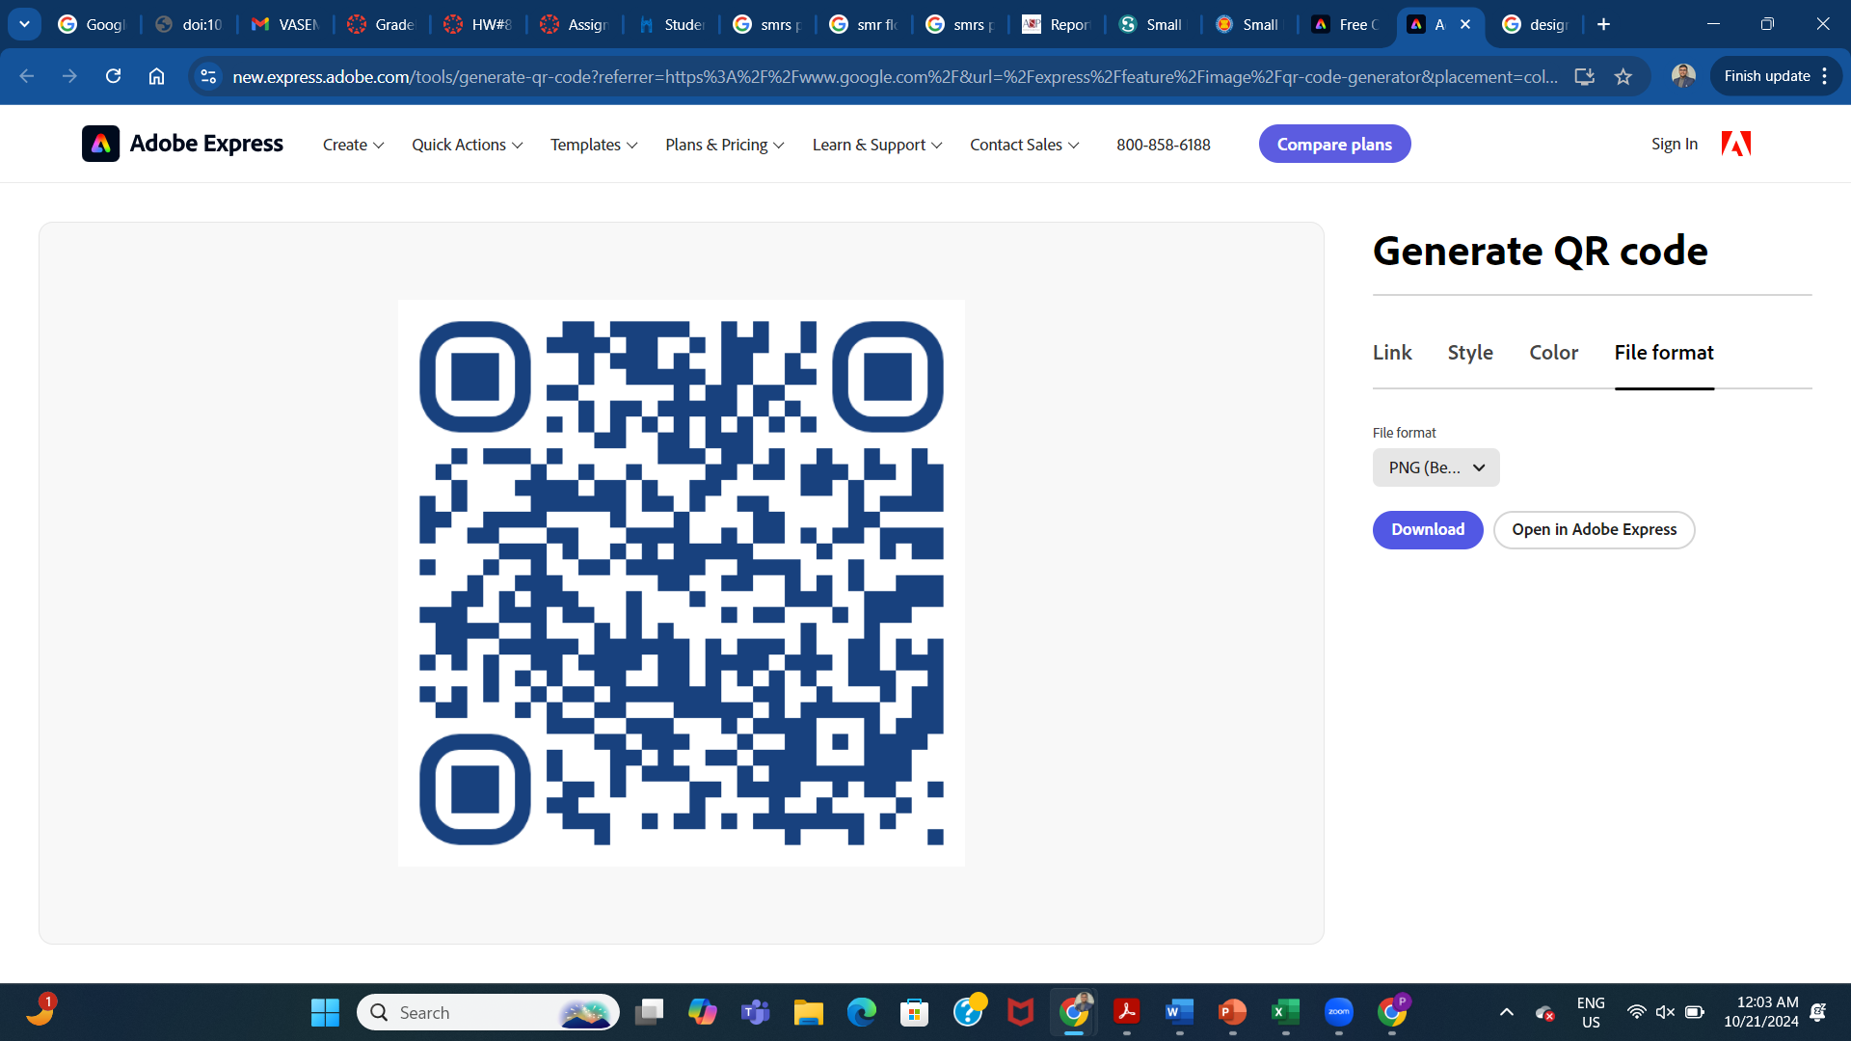
HARNESSING SMALL MODULAR REACTOR (SMR) AND HYDROGEN TECHNOLOGIES FOR SUSTAINABLE ENERGY FUTURE
Presenter - Pavan Chaitanya
INTRODUCTION
SMRs offer scalable, flexible nuclear power solutions with enhanced safety features and reduced capital costs, while hydrogen is increasingly recognized for its potential as a clean fuel for energy storage, transportation, and industrial applications.
HYDROGEN TECHNOLOGY: SHAPING THE HYDROGEN ECONOMY
Policy Considerations:
Developing financial incentives, subsidies, and tax credits for hydrogen projects.
Supporting the infrastructure development for hydrogen transport, storage, and distribution.
Ensuring standardization of safety regulations across hydrogen sectors.
Fig 2. Overnight Capital Cost (left) and total investment cost (right) comparison of AP1000 vs. two SMR scenario by Late 2050s.
Fig 7. Worldwide hydrogen value chains
GLOBAL POLICY LANDSCAPE: LESSONS AND LEADERSHIP
Global Policy Initiatives:
Lessons from the European Union’s Hydrogen Strategy for scaling hydrogen projects.
The role of international organizations in harmonizing regulatory standards and safety protocols.
Global funding mechanisms such as the Clean Energy Ministerial’s Hydrogen Initiative.
Fig 1. Integration of fossil-energy into hydrogen economy
Fig 4. The volumetric energy density of a range of fuel option.
EXISTING POLICY SITUATION
The Nuclear Regulatory Commission (NRC) has implemented new licensing pathways to expedite the deployment of SMRs.
The hydrogen policies are designed to reduce the cost of hydrogen production and incentivize investment in hydrogen infrastructure.
Fig 3. Hydrogen production cost ranges and averages by technology and equivalent prices for fossil sources with Co2 capture and storage.
Fig 6. Global potential for future use of hydrogen
ACKNOWLEDGEMENT
I would like to thank VASEM, VCU and VDOE for giving me this prestigious opportunity. A special thanks my mentors at VDOE and my advisor Dr. Karla Mossi for all the support and guidance.
SMR TECHNOLOGY: POLICY IMPLICATIONS FOR NUCLEAR INNOVATION
SMRs require regulatory adaptation to ensure rapid deployment while maintaining rigorous safety and environmental standards.
Policy Considerations:
Streamlining regulatory approval processes for SMRs.
Providing government-backed financial incentives and loan guarantees.
Encouraging international collaboration on SMR deployment and regulation.
CONCLUSION: A POLICY ROADMAP TO A DECARBONIZED FUTURE
Policy Priorities:
Providing strong financial support for SMR and hydrogen R&D.
Crafting flexible regulatory frameworks that adapt to emerging technologies.
Encouraging international policy alignment to standardize safety and operational protocols.
Fig 8. Hydrogen Uses, national benefits and relationship of FE’s R&D program elements to comprehensive hydrogen strategy.
References
1.energy.gov/sites/prod/files/2020/07/f76/USDOE_FE_Hydrogen_Strategy_July2020.pdf
2. royalsociety.org/-/media/policy/projects/climate-change-science%20solutions/climate-science-solutions-hydrogen-ammonia.pdf
3. Hydrogen Energy in Virginia
Fig 5. Schematic of the production options for low-carbon hydrogen

Slide 15
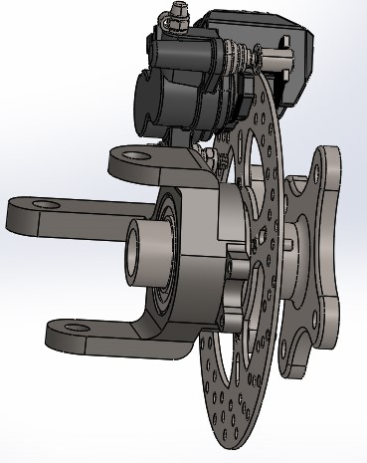
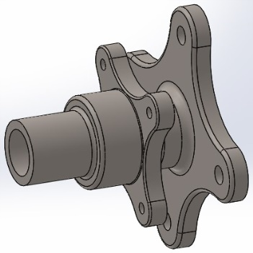
SAE BAJA BRAKING
Complete Braking Design Assembly
A detailed structural and thermal analysis of the brake disc was performed to evaluate stress distribution, deformation, and temperature rise during braking events.
Finite Element Analysis (FEA) was conducted to ensure the disc could withstand repeated thermal cycles and mechanical loads without failure. The design process emphasized lightweight construction, effective heat dissipation, and safety compliance, contributing to a responsive and durable braking system for the BAJA vehicle.
Vehicle Wheel Hub Design

Slide 16
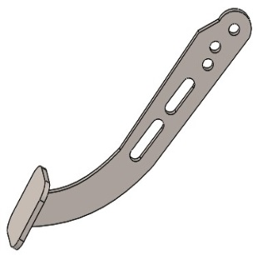
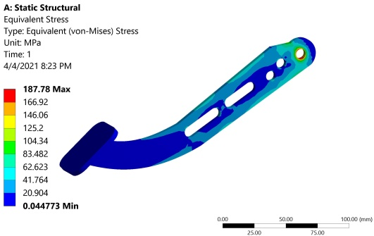
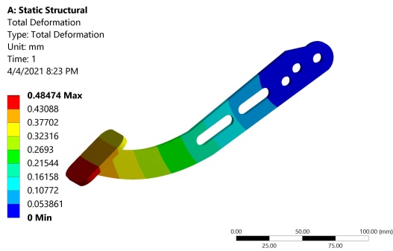
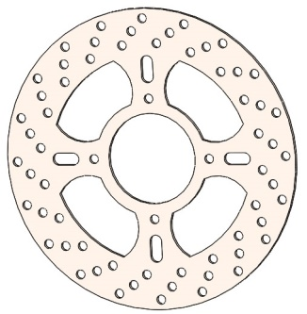
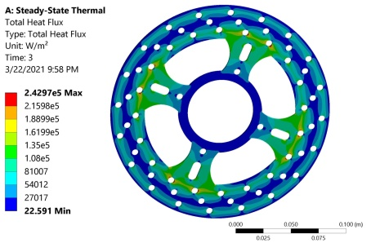
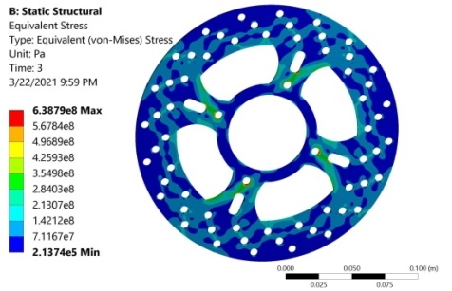
SIMULATION RESULTS
Brake Pedal
Brake Disc

Slide 17
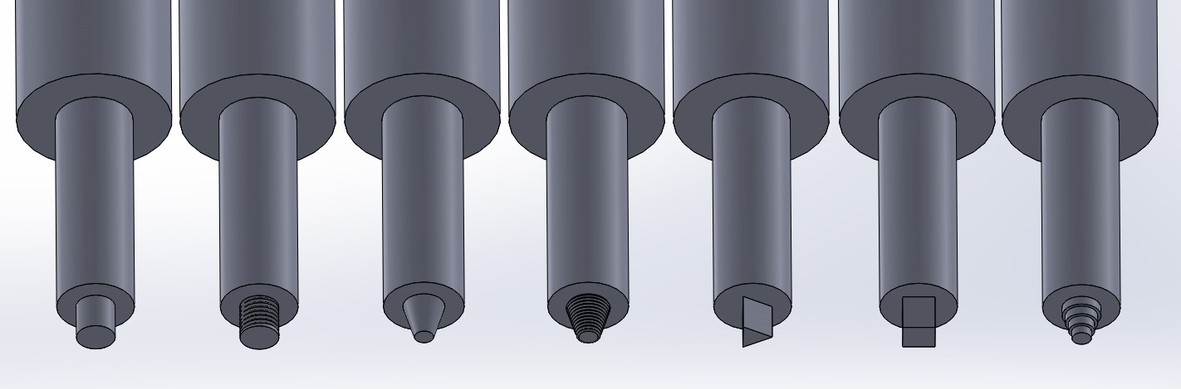
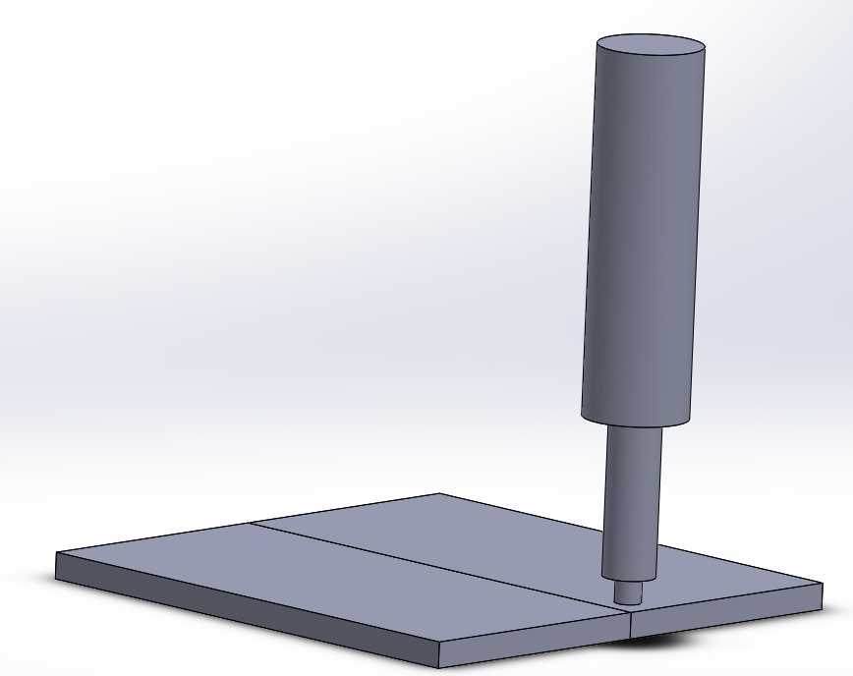
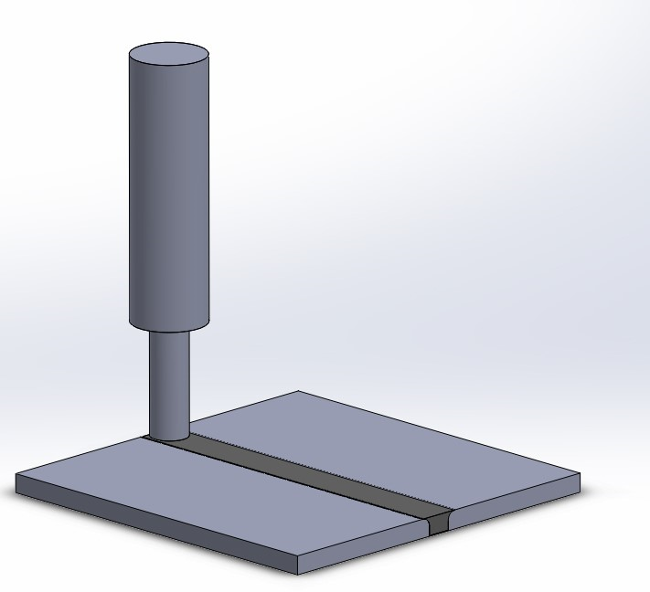
FRICTION STIR WELDING OF DISSIMILAR ALLOYS
Tool Profiles
Peak temperature, torque, and material hardness were calculated using established constitutive models for both similar and dissimilar alloys.
Position analysis for dissimilar alloys was conducted by varying tool rotational speed and translational speed at each weld position.
Finite element simulations of the friction stir welding (FSW) process were performed under both similar and dissimilar material conditions, with variations in test parameters.
Tool rotational and translational speeds were adjusted for different weld positions, and von Mises stresses and peak temperatures were simulated. The simulated peak temperatures showed close agreement with analytical models, with a maximum error of just 4.40%.
Before and After Welding Process Design

Slide 18
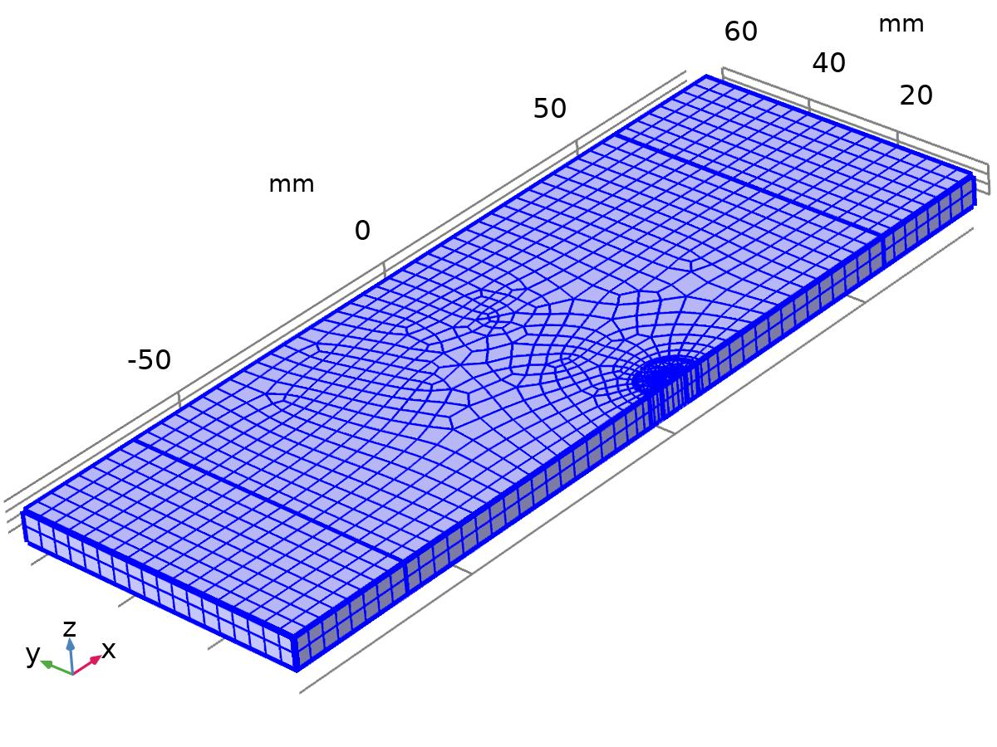
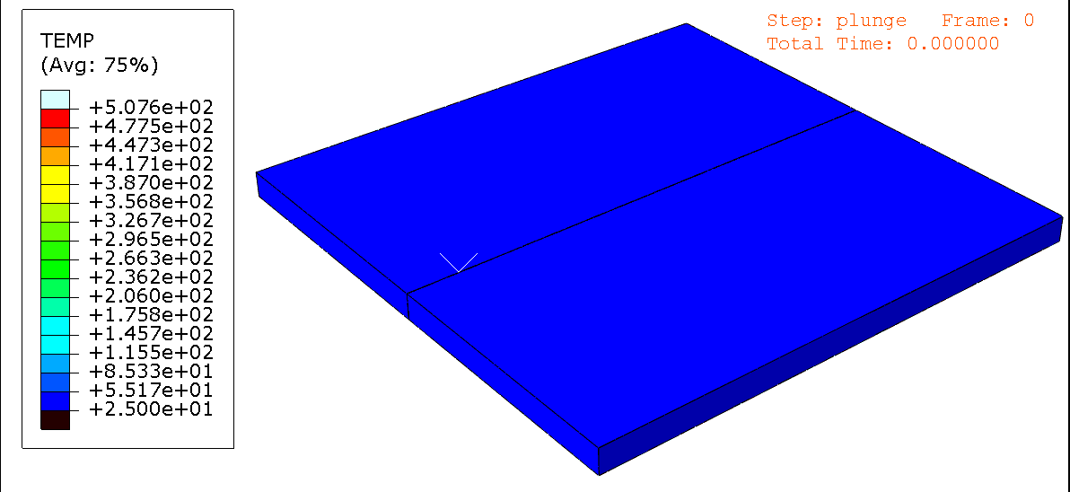
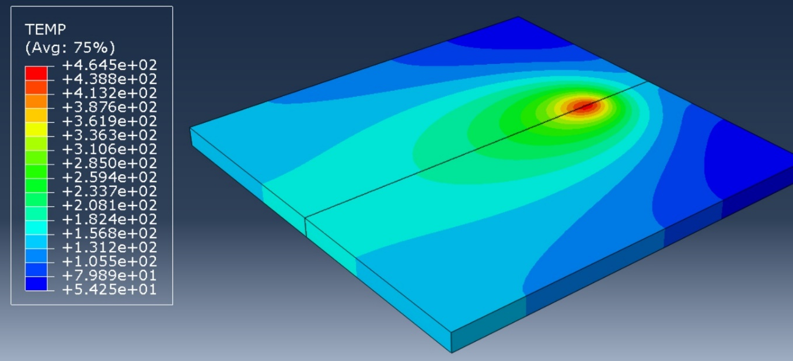
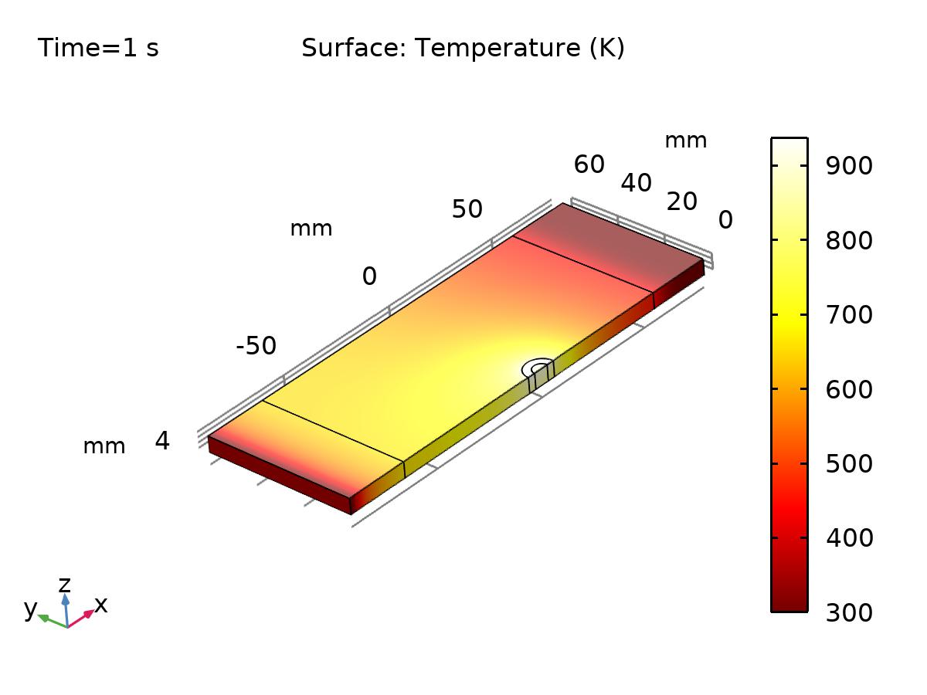
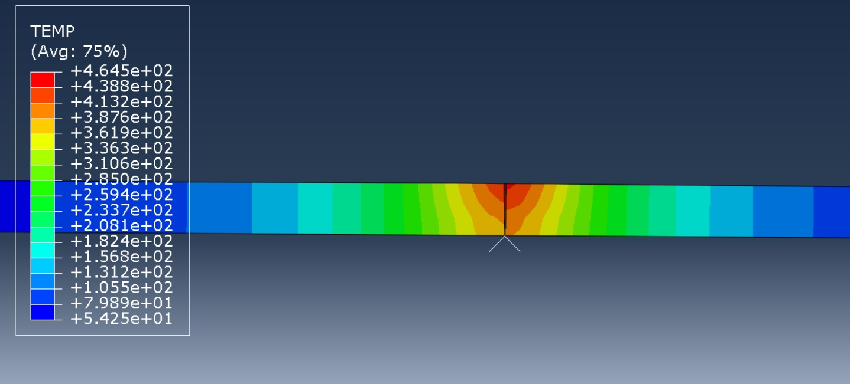
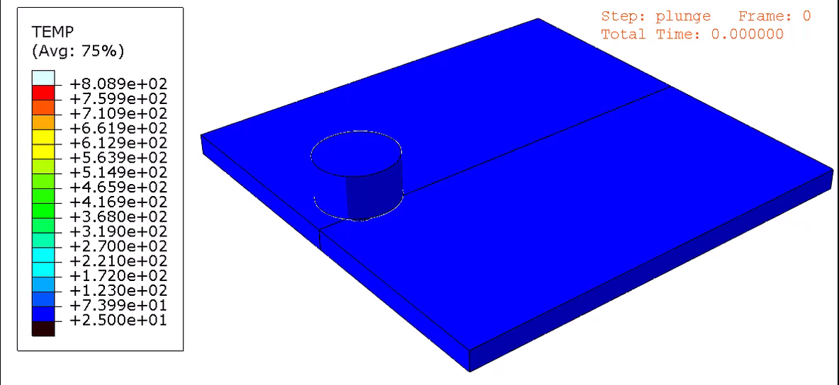
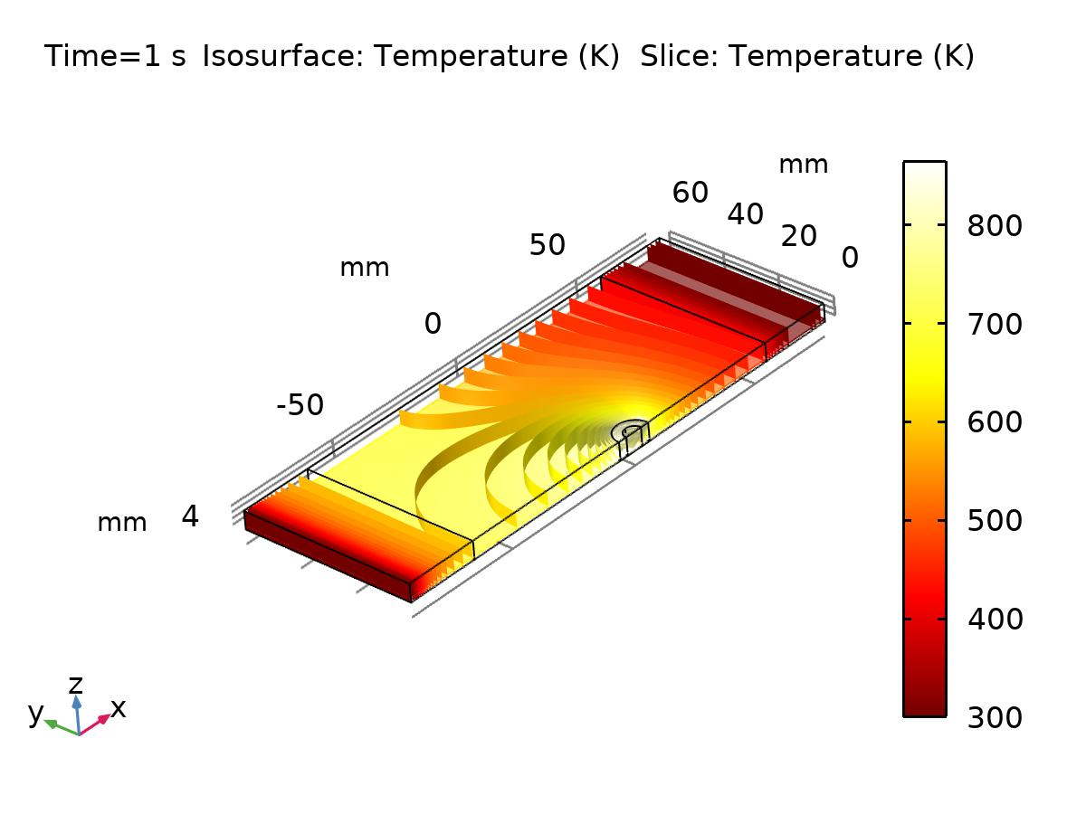
SIMULATION RESULTS
ABAQUS Results
COMSOL Results

Slide 19
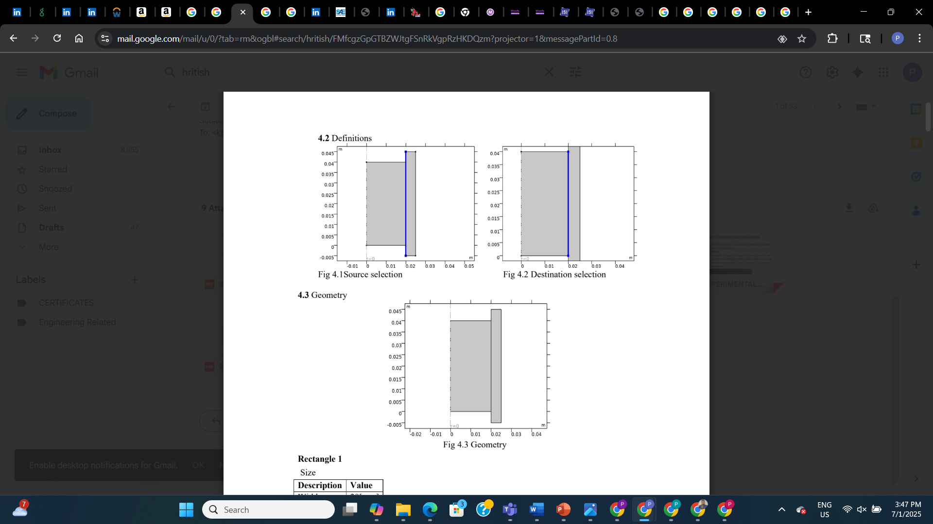
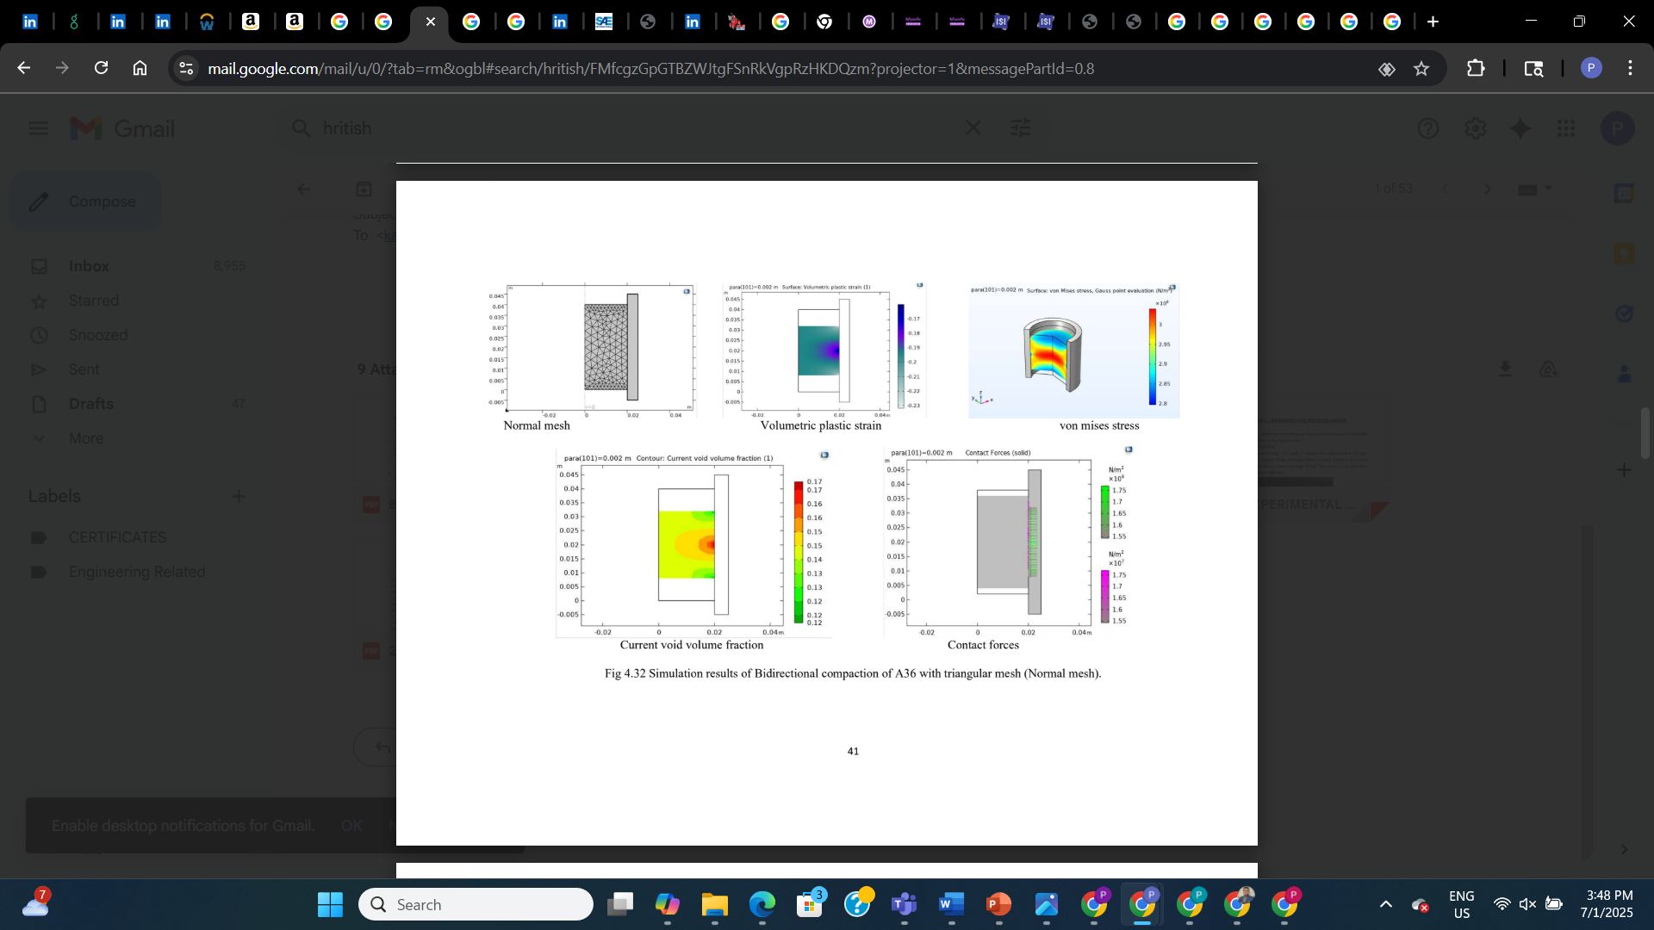
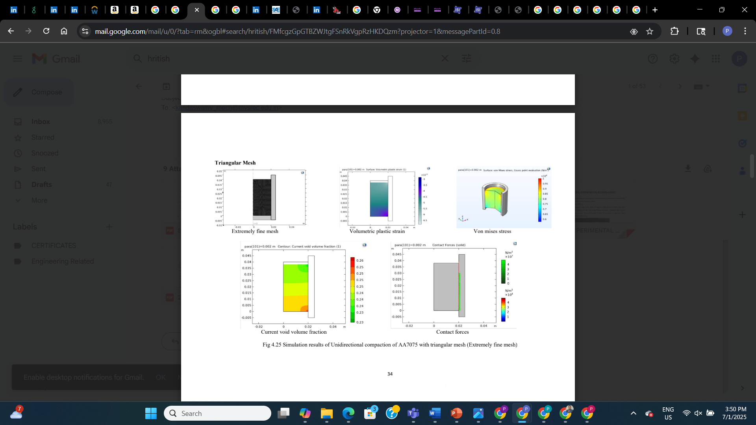
FINITE ELEMENT SIMULATION OF MECHANICAL BEHAVIOUR IN NON FERROUS ALLOYS DURING POWDER COMPACTION (Al 7075)
Profile Sketch
Stresses induced in the powder compact are observed to be more in unidirectional as compared to bidirectional compaction in both ferrous and non ferrous alloys.
Finite element simulations results indicate Void Volume fraction is more in non ferrous alloy as compared to ferrous alloy.
Von mises stresses, Strain energy and Equivalent elastic strain are observed to reduce with increase in temperature and pressure due to fine compaction and enhanced intermolecular bonding.
Contact tool pressure and reaction forces are observed to increase with increase in temperature and pressure.
Bi-Directional Compaction
Uni-Directional Compaction

Slide 20
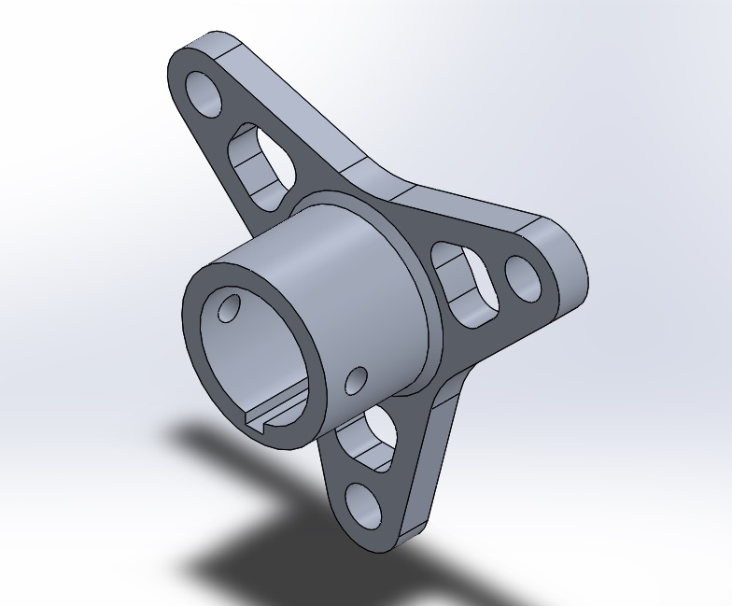
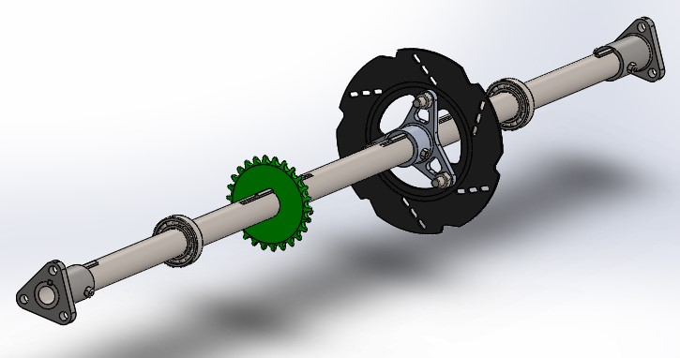
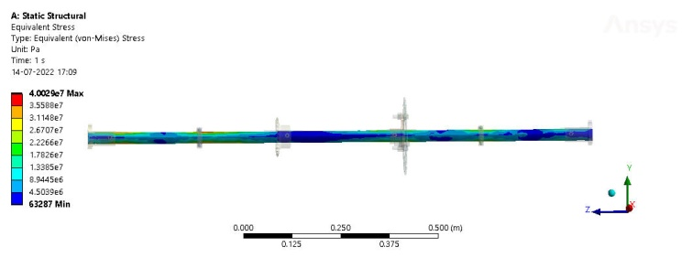
GO-KART POWER TRANSMISSION
Brake Hub Design
Each component was modeled for minimal weight without compromising performance. Structural analysis was performed under various loading conditions, including torque transmission, braking force, and wheel loads, to validate durability and safety.
The design achieved a balanced solution that enhanced performance, reduced inertia, and improved overall efficiency of the drivetrain.
Complete Power Transmission Design Assembly
Complete Power Transmission FEA

Slide 21
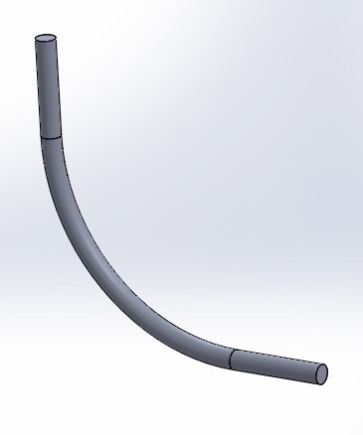
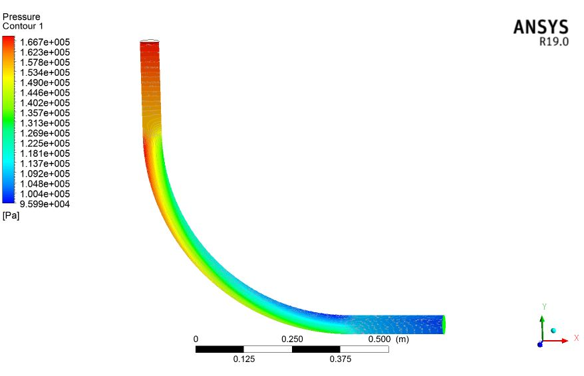
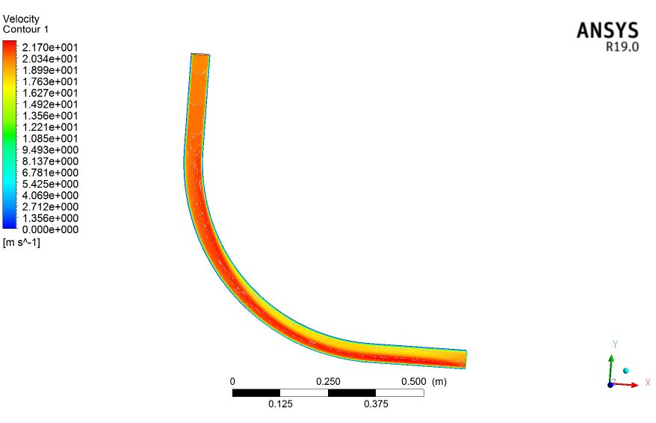
PRESSURE DROP ANALYSIS OF A BEND PIPE TO OBSERVE CHANGE IN PRESSURE
Pipe Design
The objective was to observe how the change in flow direction affects pressure distribution and fluid velocity. A detailed 3D model of the bend pipe was created and meshed, with appropriate boundary conditions applied to simulate inlet velocity and outlet pressure.
Results highlighted significant pressure losses at the bend due to flow separation and turbulence, providing insights into design considerations for minimizing energy losses in piping systems.
Analysis Results

Slide 22
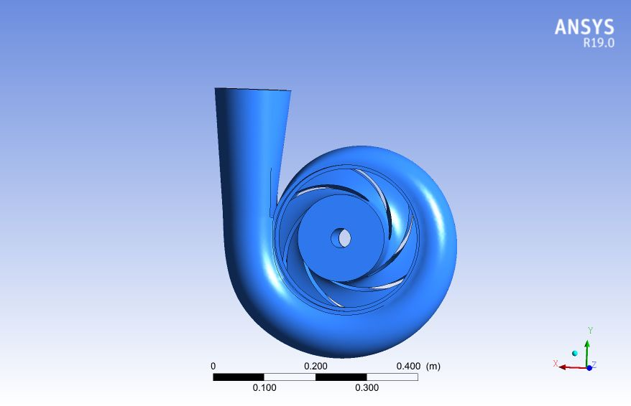
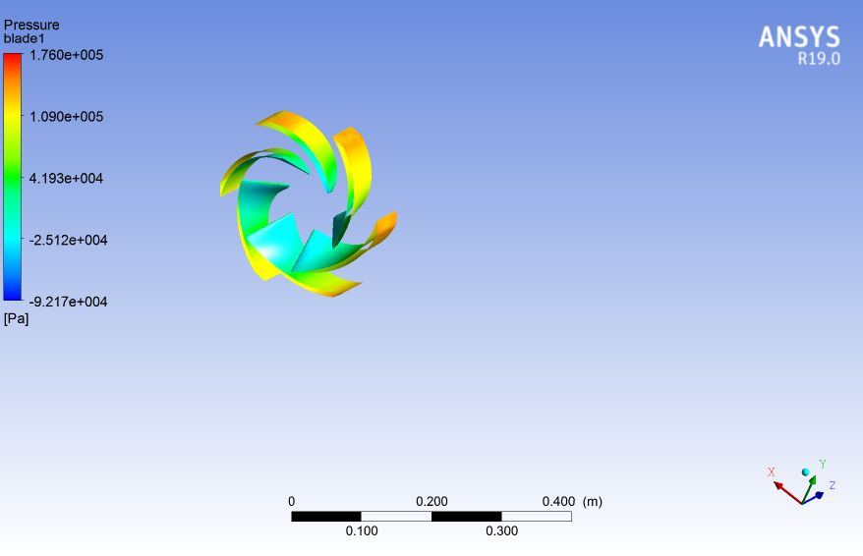
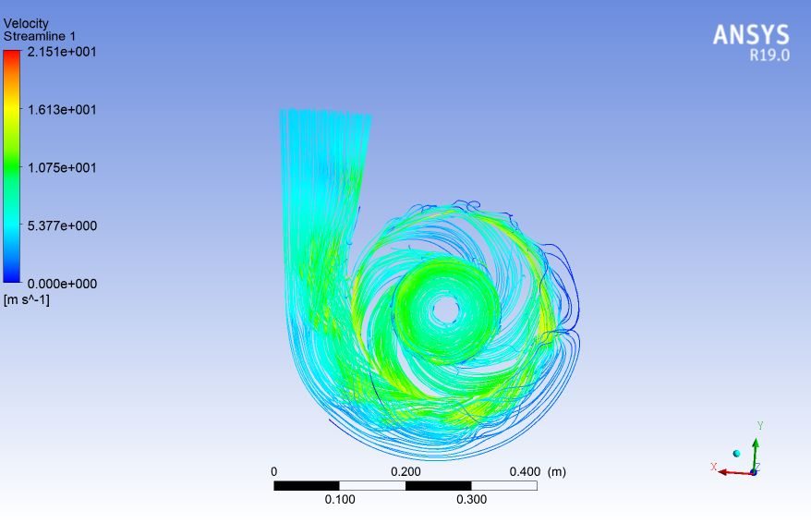
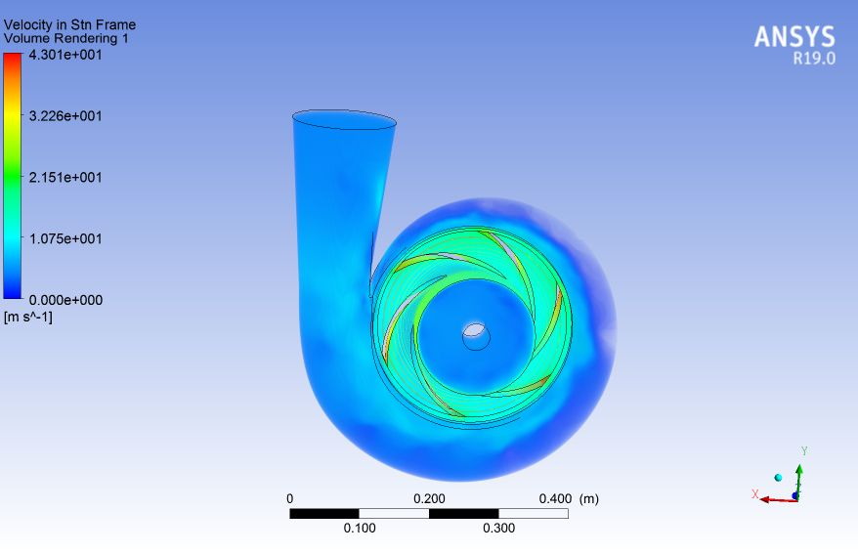

PERFORMANCE ANALYSIS OF A CENTRIFUGAL PUMP TO OBTAIN OUTPUT PRESSURE PARAMETERS
Pump Design
Conducted CFD-based performance analysis of a centrifugal pump to evaluate key output pressure parameters under various operating conditions. The study involved modeling the impeller and volute geometry, followed by mesh generation optimized for capturing complex internal flow patterns.
Simulations were carried out to analyze pressure rise and velocity distribution across the pump. Boundary conditions were defined to simulate realistic inlet flow rates and rotational speeds.
The results provided insights into flow separation, recirculation zones, and pressure fluctuations, enabling performance optimization and validation against theoretical and empirical models.
CFD Analysis Results

Slide 23




EXTERNAL FLOW ANALYSIS OVER A SEDAN CAR TO GET THE DRAG AND LIFT VALUES PARAMETERS
The 3D model of the car was developed and refined to capture realistic geometry, followed by high-quality mesh generation to resolve boundary layer effects and wake regions.
Simulations were conducted under steady-state conditions using appropriate turbulence models to study pressure distribution, streamline behavior, and flow separation zones.
The analysis provided accurate values for drag and lift coefficients, offering insights into aerodynamic efficiency and guiding design modifications to reduce resistance and improve stability at high speeds.
CFD Analysis Results

Slide 24



COMPUTATIONAL FLUID DYNAMIC ANALYSIS OF NACA 0006 AEROFOIL AT DIFFERENT PARAMETERS WITH REGRESSION ANALYSIS
Meshed Boundary Sketch
This study investigates the factors influencing the performance of an aerofoil that is intended to be used in a flight system. The inlet flow velocity along the surface of the aerofoil geometry is varied from 5 to 25m/s with 5m/s interval.
A numerical investigation using ANSYS Fluent, of two-dimensional incompressible flow over a NACA 0006 aerofoil is analysed at various mach numbers by varying angle of attack.
At higher AoA better lift can be obtained by using this aerofoil so, the fuel efficiency will be improved by about 8%. The simulated value of the coefficient of lift is in good fit and with high accuracy to the mathematical model equation.
Meshed Boundary Sketch around the profile
CFD Analysis Results

Slide 25



INTERNAL FLOW ANALYSIS INSIDE A TUBE WITH MULTIPLE BRANCHES
Conducted CFD analysis of an exhaust manifold to investigate internal flow characteristics, pressure distribution, and thermal behavior under engine-like conditions.
The manifold geometry featured multiple inlet branches converging into a single outlet, representative of typical multi-cylinder engine systems. The analysis aimed to optimize flow uniformity, reduce backpressure, and improve thermal efficiency.
Tube With Multiple Branches Design
CFD Analysis Results

Slide 26


EXTERNAL FLOW ANALYSIS OVER A F1 CAR TO ANALYZE LIFT AND DRAG PARAMETERS
Car Design
The 3D geometry of the F1 car was modeled with detailed aerodynamic features such as wings, diffusers, and side pods. High-resolution meshing was applied to capture flow separation, wake regions, and boundary layer effects.
Simulations were conducted under steady-state conditions using appropriate turbulence models. The analysis provided critical insights into drag reduction strategies and downforce generation, guiding design improvements.
CFD Analysis Results

Slide 27



EXTERNAL FLOW ANALYSIS OVER A JET TO ANALYZE LIFT AND DRAG PARAMETERS
Jet Design
The 3D model included fuselage, wings, and control surfaces, with fine meshing applied to capture boundary layer development and wake effects. Steady-state simulations using turbulence models were performed to visualize pressure distribution, streamline patterns, and flow separation zones. Key aerodynamic parameters, including lift and drag coefficients, were extracted to assess performance and inform design optimization.
CFD Analysis Results

Slide 28


CFD ANALYSIS OF VACCINATION TUBES
Conducted CFD analysis to evaluate fluid flow behavior within a specialized vaccination tube assembly, designed with three small vertical inlet tubes connected to a larger horizontal outlet tube. The objective was to ensure uniform flow distribution and minimal pressure drop, critical for consistent vaccine delivery.
The 3D geometry was modeled and meshed with a focus on capturing internal flow characteristics, junction effects, and turbulence behavior. Boundary conditions were applied to simulate realistic fluid input rates through the vertical tubes.
The analysis provided insights into velocity profiles, pressure gradients, and potential flow imbalances, enabling optimization of tube dimensions and junction design to enhance flow uniformity and reduce stagnation zones.
CFD Analysis Results

Slide 29


STRESS ANALYSIS OF CONNECTING ROD
Connecting Rod Design Assembly
Performed structural stress analysis on an internal combustion engine connecting rod to evaluate its strength and durability under operating loads.
The 3D model of the connecting rod was developed using CAD software and analyzed using Finite Element Analysis (FEA) to simulate stresses during both compression and tension strokes. Boundary conditions were applied to replicate realistic engine forces, including peak combustion pressure and inertial loads.
The analysis focused on identifying critical stress zones, deformation patterns, and factor of safety. Results were used to propose design improvements for enhanced fatigue resistance and weight optimization, contributing to more efficient and reliable engine performance.
FEA Results

Slide 30




CFD ANALYSIS OF PROPELLER
Propeller Design
The study involved modeling the 3D geometry of the propeller, generating a high-quality mesh, and setting up boundary conditions to simulate realistic operating environments.
Simulations were conducted using steady-state and transient solvers to analyze pressure distribution, velocity fields for different blade profiles.
CFD Analysis Results

Slide 31


MOBILE ROBOTICS
Designed and built a variety of autonomous robotic systems, including a line follower robot, a solar-powered obstacle-avoiding robot, and an intelligent obstacle-avoiding robot equipped with multiple sensor configurations. These projects incorporated ultrasonic sensors (HC-SR04) and infrared (IR) sensors for precise distance measurement and path correction.
The solar-powered robot demonstrated energy-efficient mobility, while sensor integration enabled dynamic navigation in real-time environments.
These projects enhanced my understanding of embedded systems, sensor fusion, and autonomous navigation, and provided hands-on experience in hardware interfacing, control logic programming, and real-world system optimization.
Robotics Models

Slide 32

PICK AND PLACE MOBILE ROBOT
Designed and built a mobile robot using Arduino to autonomously pick up objects from a specified location and place them at a target destination.
The system features a servo-controlled mechanical gripper, motor-driven mobility, and basic obstacle detection for navigation. Arduino was used to control the robot's movement, coordinate the pick-and-place mechanism, and process input from sensors.
This project demonstrated efficient task automation for material handling, with potential applications in manufacturing, packaging, and small-scale industrial environments.
Pick and Place Mobile Robot

